Slide 1

ME 221-S3 MAT-SCI VISIONARIES L4: Surface engineering and the methodologies used to modify material surfaces for specific functionalities and applications
TEAM:
TANUJ AGRAWAL
AYUSH MISHRA
GARVIT JAIN
ATHARVA KASAR
VENU ARRAVINTH R

Slide 2
SURFACE ENGINEERING
It is a field that focuses on surface modifications to enhance the surface properties without affecting bulk properties(Not even its microstructural nature!!!)
PHYSICAL METHODS
SURFACE ENGINEERING
CHEMICAL METHODS
MICROSTRUCTURAL MODIFICATION
COMPOSITIONAL MODIFICATION
SURFACE HARDENING TECHNIQUES
SHOT PEENING
ALL KINDS OF COATING AND DEPOSITION PROCESSES
SURFACE MELTING

Slide 3
COMMONLY USED INDUSTRIAL PROCESSES
Carburization:
Applied to low-carbon steels. Treated in carbon-rich ambient at higher temperature (950 Celsius) and exposure time. It is a thermo-chemical, diffusion-driven process.
Deeper points in the substrate eventually get hardened (Good for specific purposes)
Nitriding: Similar to carburization expect that the workpiece is treated in a nitrogen-rich environment and carried out at a relatively lower temperature. More exciting pieces of information are coming ahead!!
Gas Nitriding – For alloy steels, for precise general hardness and corrosion resistance, more control over nitriding depth
Salt-Bath Nitriding – For automotive and stainless steels, particularly for higher wear resistance and fatigue life
Ion Nitriding– Impingement of Ionized and reactive Nitrogen atoms, particularly for very high hardness, used for tool steels

Slide 4
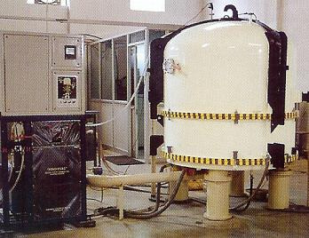
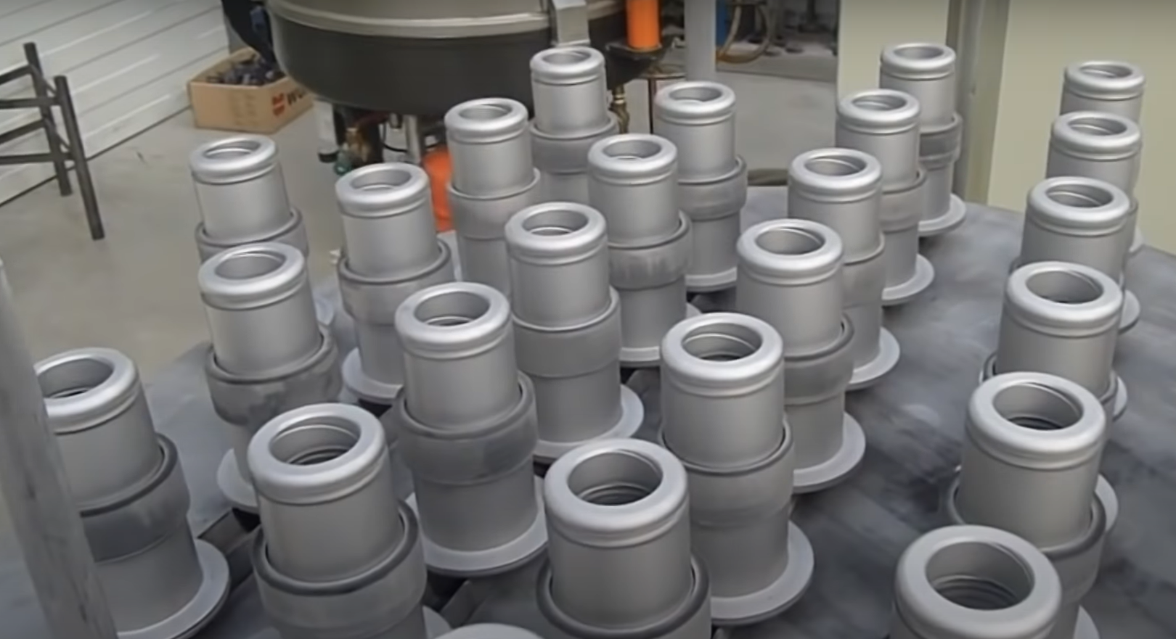
😎COOLEST NITRIDING PROCESS – ION NITRIDING

Slide 5
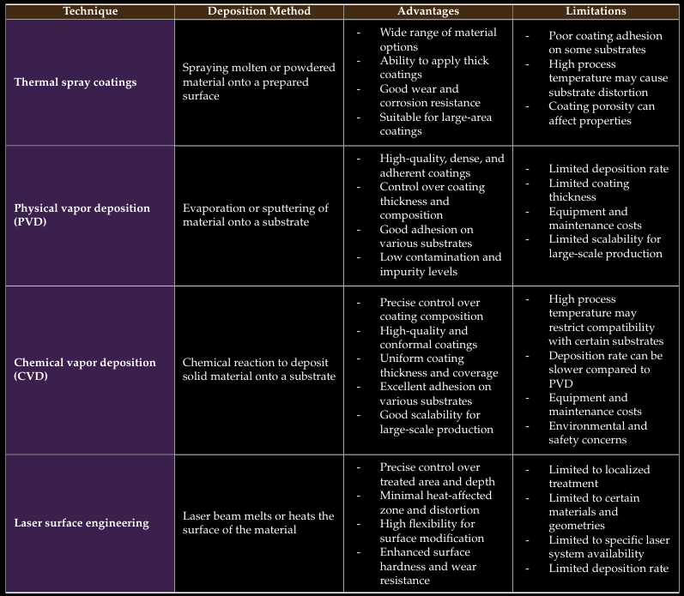

Slide 6
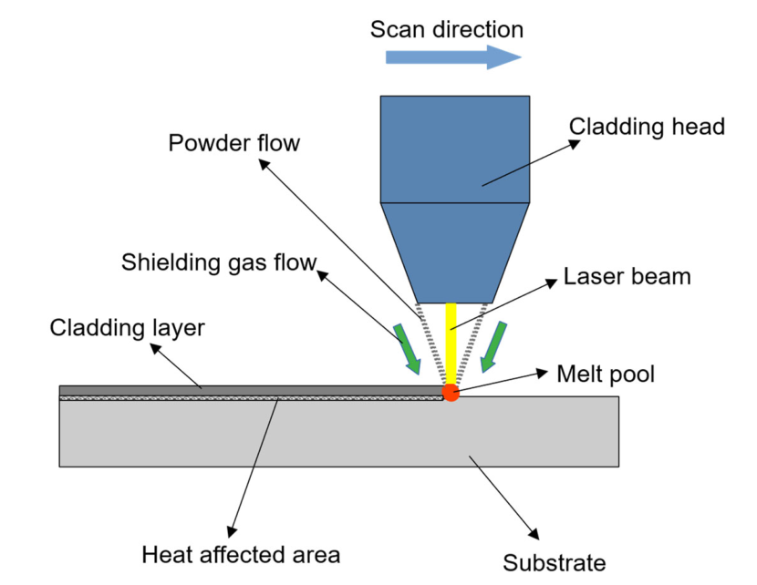
ONE MORE😉? LASER SURFACE ENGG.
Using lasers to change the surface characteristics of metals is known as laser surface engineering.
Very effective for enhancing localized properties (Ex: near hinges where stresses are high and hardness is required locally)
Steps:
1. Focus the laser beam to heat
2. The surface melts locally
3. Rapid (Non-equilibrium) solidification of the area
3. Tailor the properties by controlling the cooling rate

Slide 7
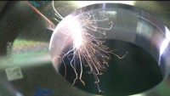

Slide 8
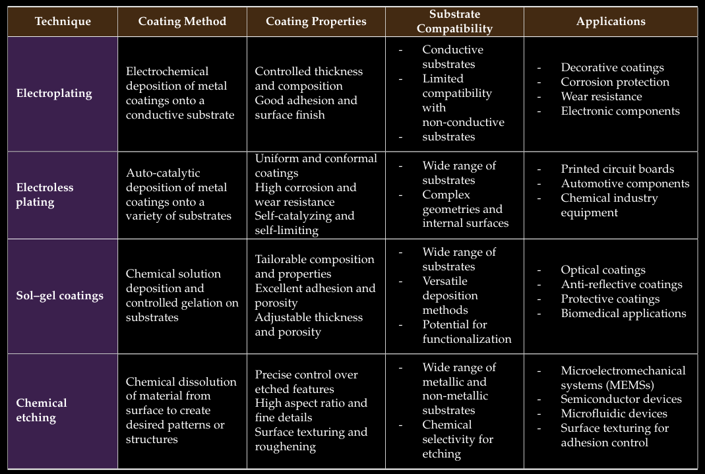

Slide 10

WHAT IS
A CASE STUDY ON CRANKSHAFTS
A CASE STUDY ON CRANKSHAFTS

Slide 11

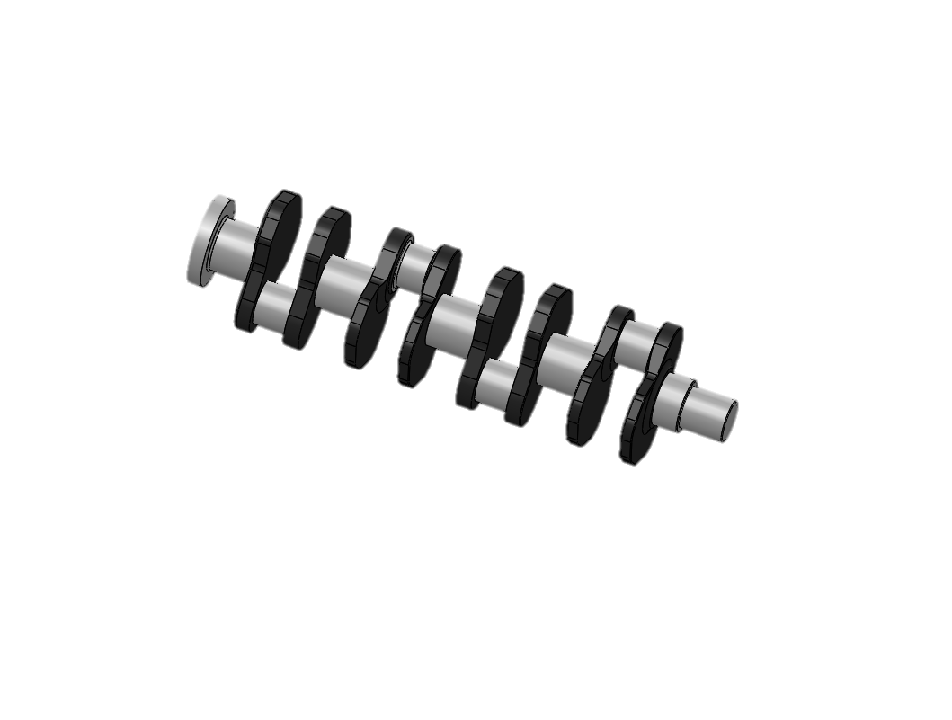
THIS PISTON IS COATED USING SURFACE TREATMENT PROCESS CALLED NITRIDING

Slide 12
THE CRANKSHAFT IS COATED USING SURFACE TREATMENT PROCESS CALLED NITRIDING
AISI 1045 FORGED STEEL
(~0.5% Carbon)
FACES EXTREME WEAR AND FATIGUE CONDITIONS !

Slide 13
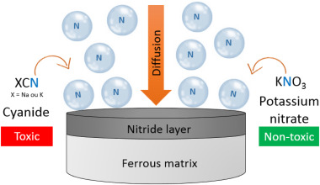
SALT BATH NITRIDING
NITRIDING MIXTURE AND HEATING
Molten Na and K salts, nitrogen-rich compounds, and release of nascent nitrogen atoms at high temperatures
DIFFUSION
Diffusion of Reactive Nascent Nitrogen
PROCESS
Formation of diffusion layer of Nitrides (Iron Nitrides in case of the crankshaft)

Slide 14
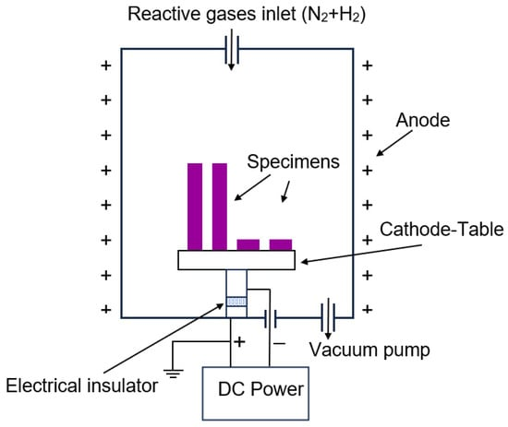
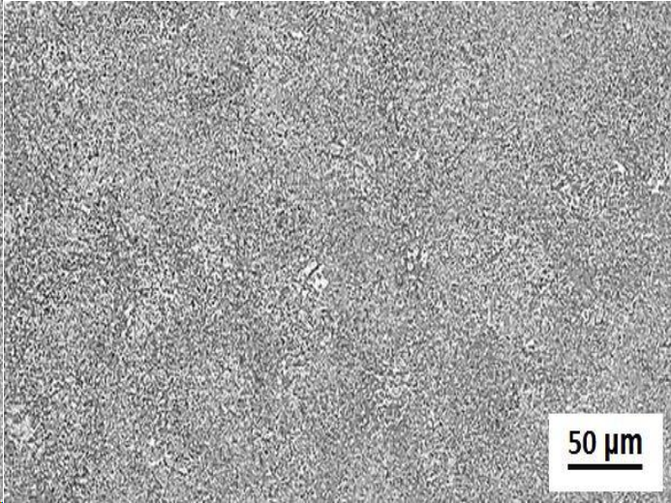
MICROSTRUCTURAL ANALYSIS
Firstly, the thickness of the nitrided layer increases as the temperature increases. Because Nitriding involves long-range diffusion and temperature favours the phenomenon
The nitrided layer has an equiaxed grain structure (smaller, spherical grains) because recrystallization happens at the surface, which breaks bigger grains into smaller ones
Ni and Cu precipitation in the nitrided layer hardens and roughens the surface of the crankshaft (Remember Precipitation hardening)
After Nitriding (or any general surface hardening process)Bulk grain structure don’t change, and so do the bulk properties
ION FORMATION
High voltages are applied to generate Nitrogen ions and accelerate it
HEATING
Accelerated ions bombard the workpiece surface and impinge
PROCESS
Ions react with the surface of the workpiece and form a nitride layer
Salt-bath nitriding is preferably done at a specific temperature, in the range of 500-600 ⁰C.
Here we see, graphical plots for two temperatures, that is 520 and 580 centigrade.
Before the process of nitriding, the Microstructure of AISI 1045 steel looks like this

Slide 15
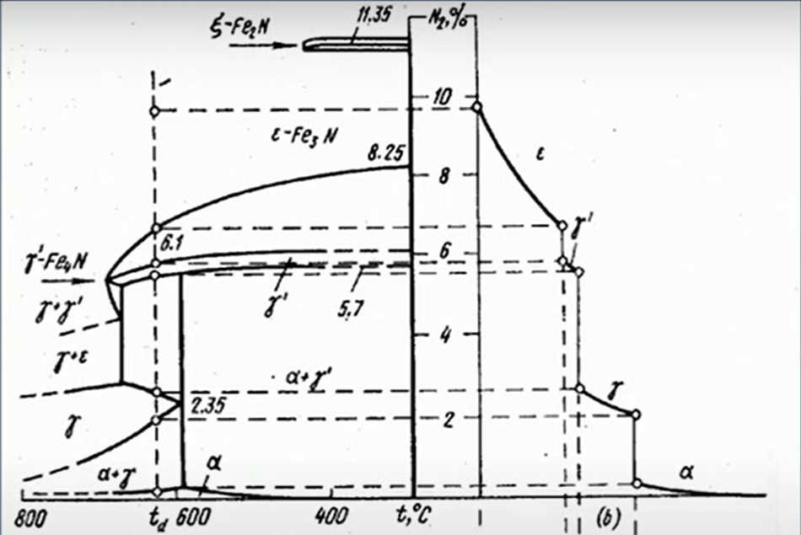
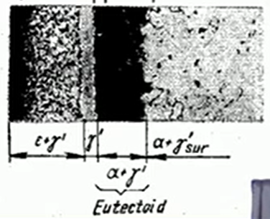
ION FORMATION
High voltages are applied to generate Nitrogen ions and accelerate it
HEATING
Accelerated ions bombard the workpiece surface and impinge
PROCESS
Ions react with the surface of the workpiece and form a nitride layer
Observe - Different phases at different depths of nitrided layer (After Nitriding)
Phase Diagram of Fe-N system

Slide 16
WHAT DOES THE ANALYSIS GIVE US?
Chemical Composition of the surface → New & enhanced properties
Fatique resistance – Presence of ε-Fe₂₋₃N provides good amount residual comp. force
Microhardness Variations (Hardness Measuring Unit: HV – Vickers Hardness)
Temperature of nitriding and time of exposure (Coarsening of precipitates)
Depth from the surface (Compound to diffusion layer)
Hardness purely depends on nitriding time when temperature is kept constant
LETS GET INTO GRAPHS !!!

Slide 17
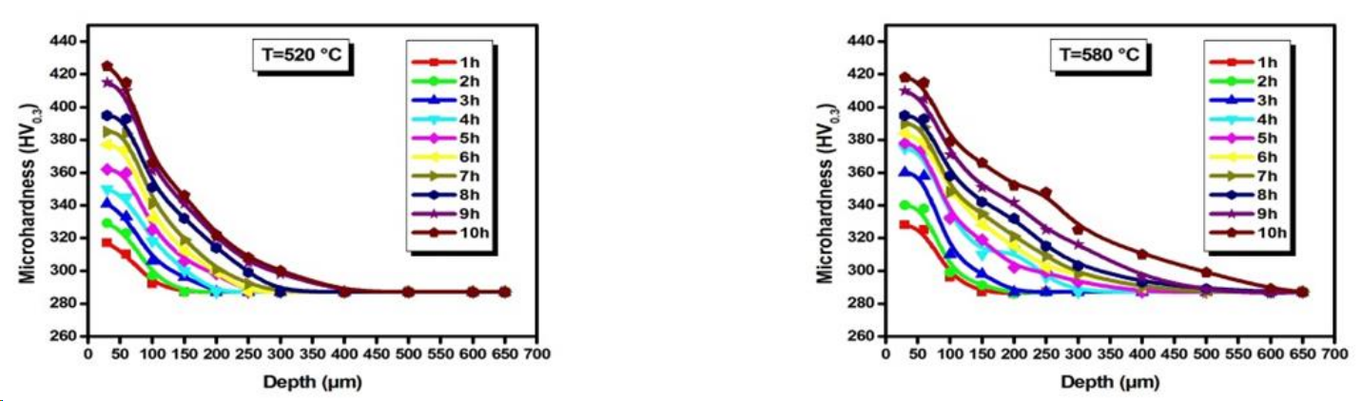
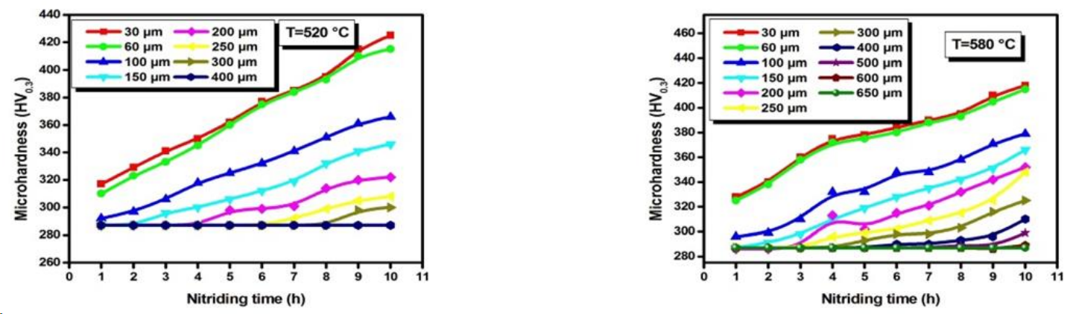
For a particular Temperature, hardness decreases as depth increases → Concentration of nitrides decreases
Also for a particular depth (lower depths) hardness is higher for higher nitriding time (Red line)
Observe: Hardness remains almost constant at high-end depths (here for example at 400 μm), because a very negligible amount of N is present at these depths at any time of exposure

Slide 18
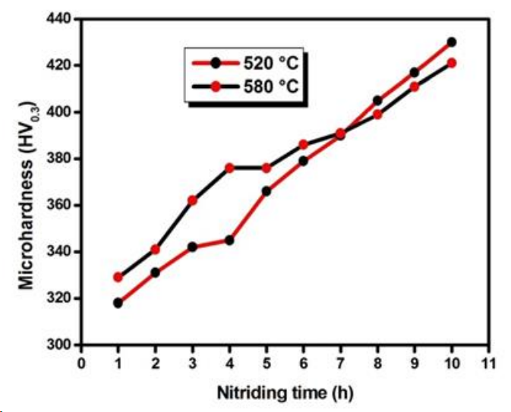
Graph representing Increase in Microhardness vs N-time for two different temperatures(520 and 580 ⁰C)
One interesting observation: At higher temperatures and higher nitriding time, an anomaly occurred
Why this happened?
When exposed to more time and high temperatures, the conditions favor the formation of large nitride precipitates, reducing the density of precipitates
Dislocations now move freely due to reduced density of obstructions and reduced the hardness

Slide 20
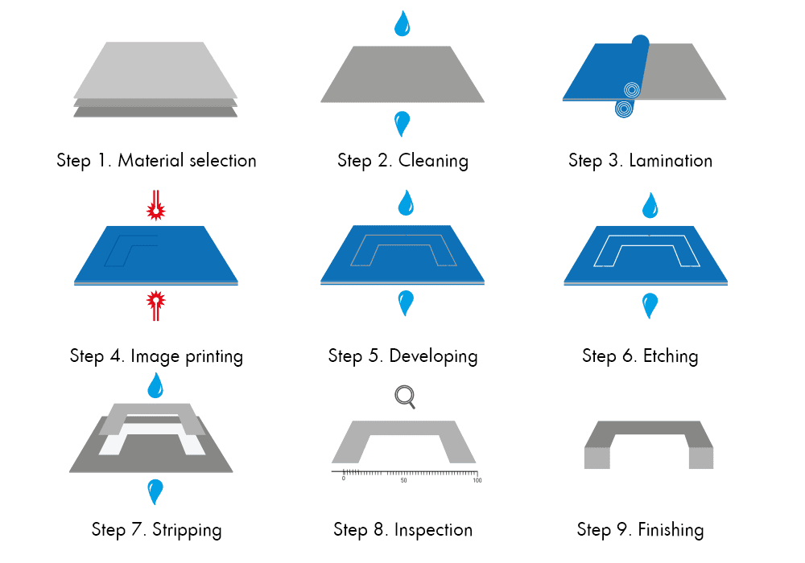
CASE STUDY ON ETCHING
Metal etching is a metal removal process that uses various methods to configure complex, intricate, and highly accurate components and shapes.
We will spotlight a specific type of etching, that is chemical etching
Chemical etching is a method of compositional modification that utilizes corrosive metals to etch. Also known as chemical milling, chemical etching is a subtractive sheet metal machining process that can create complex and highly accurate precision components from almost any metal.
The case study is to analyze the increase in shear strength of glued metallic surfaces using adhesive(DP 420 black)

Slide 21
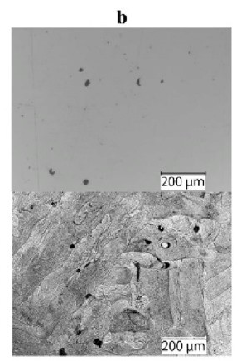
Etching solution: Distilled Water, sodium dichromate, concentrated sulphuric acid, and aluminum chips.
Metal to be etched: Aluminium
Shear strength values
Before Etching: 1500 psi (~10MPa)
After Etching: 4500 psi (~30 MPa)
Etching increased the shear stress required
to separate two glued metallic surfaces 3 times !!!
Grains are uniformly spread and SEM couldn’t differentiate grain boundaries
Dark lines are grain boundaries (etchant dissolves along the grain boundaries

Slide 22
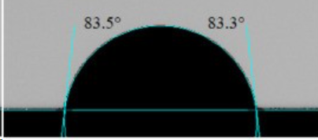
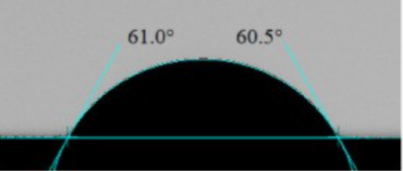
Why does the shear strength increase?
After the etching surface becomes rough the wetting angle of the adhesive decreases. These two phenomena together lead to a massive increase in the shear strength values of the glued surfaces.
Why does the surface become rough?
Because etching selectively removes material in places like grain boundaries, defective regions, etc.
BEFORE
What about grain size?
Since the etching happens selectively along grain boundaries, its grain size doesn’t change appreciably!!
AFTER

Slide 23

Thanks!
Any questions?
Please keep this slide for attribution

Slide 24
Resources
liquid nitriding
industrial nitriding for automotive parts
Basics and types if surface engg.
AISI steel nitriding analysis
https://docs.google.com/document/d/1RtiDGPYn9Ys4Jid1sTw40jCrpqLGDamX/edit?usp=sharing&ouid=116056840884675254991&rtpof=true&sd=true
Wikipedia
Pexel videos and images
Google images
Template - Slidesgo.com

